Slide 1




Slide 2


Get Started With React
Part One

Slide 3

Who am I
ZOUAMBIA SOHAIB
ESI Algiers Student
GDG Algiers Webmaster
Github Campus Expert

Slide 4

What to learn in this training
(Part 1)
Introduction to Frameworks
Create your first React App
Components & JSX
Styling in React
Handling events
React Hooks
State and useState hook
React dev tools
Lists & keys in React
React props

Slide 5


Get Ready

Slide 6


What is a framework ?
A framework is a structure that you can build software on. It serves as a foundation, so you're not starting entirely from scratch. Frameworks are typically associated with a specific programming language and are suited to different types of tasks.

Slide 7

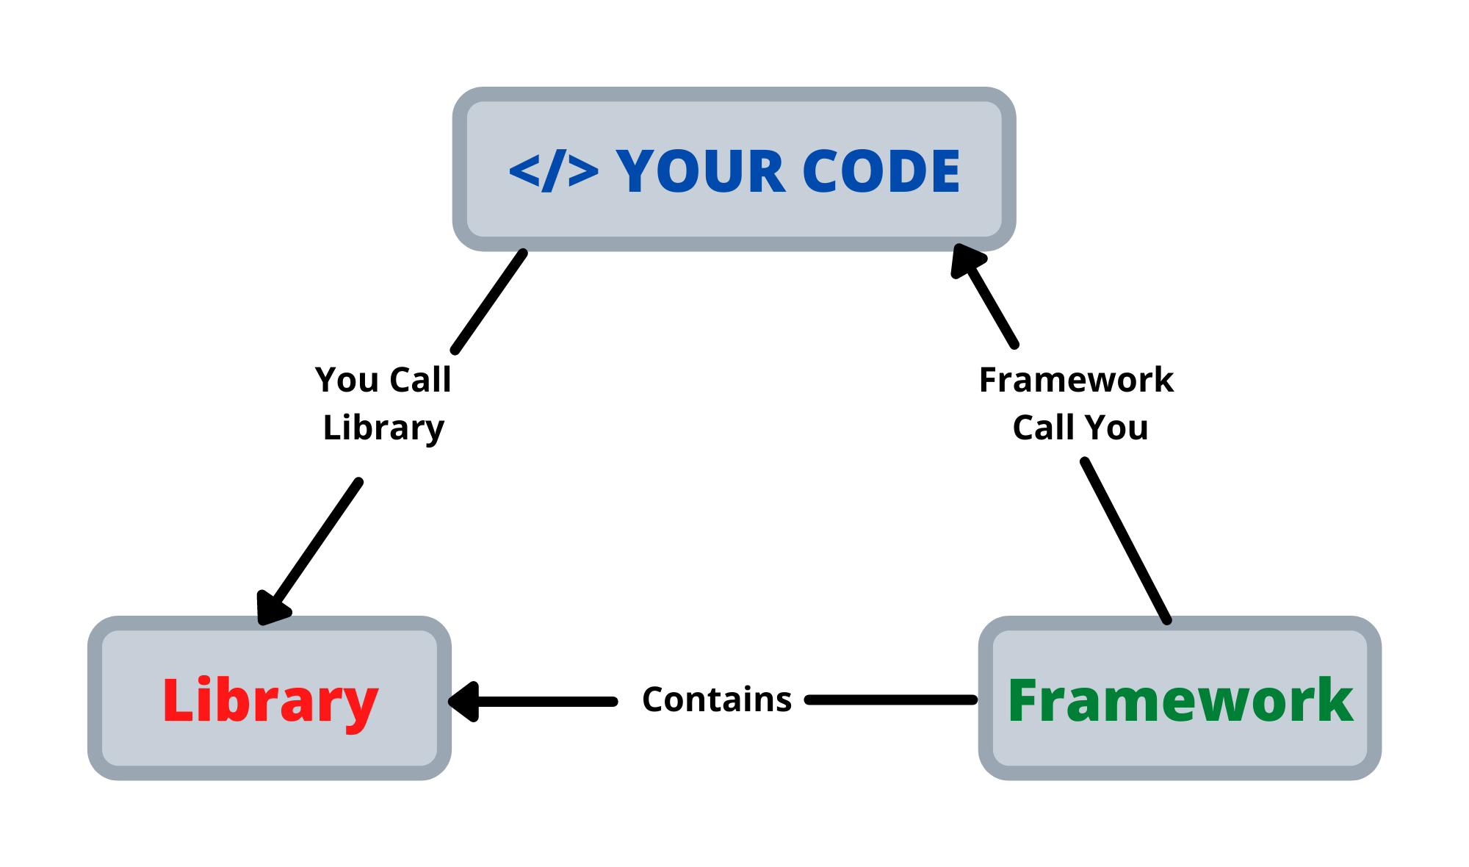
A FRAMEWORK IS NOT A LIBRARY

Slide 8
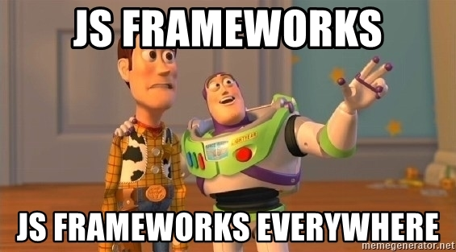
Use a framework to:
Save time, avoid duplicate code and reduce the risk of getting errors
More secure, clean and easily adoptable code
Simpler testing and debugging

Slide 9
Now let’s talk React

Slide 10
Why use React ?
Reusable Components
Easy Integration
Simpler Syntax
SEO
Virtual DOM
Continuous Improvement
Huge Community Support

Slide 11
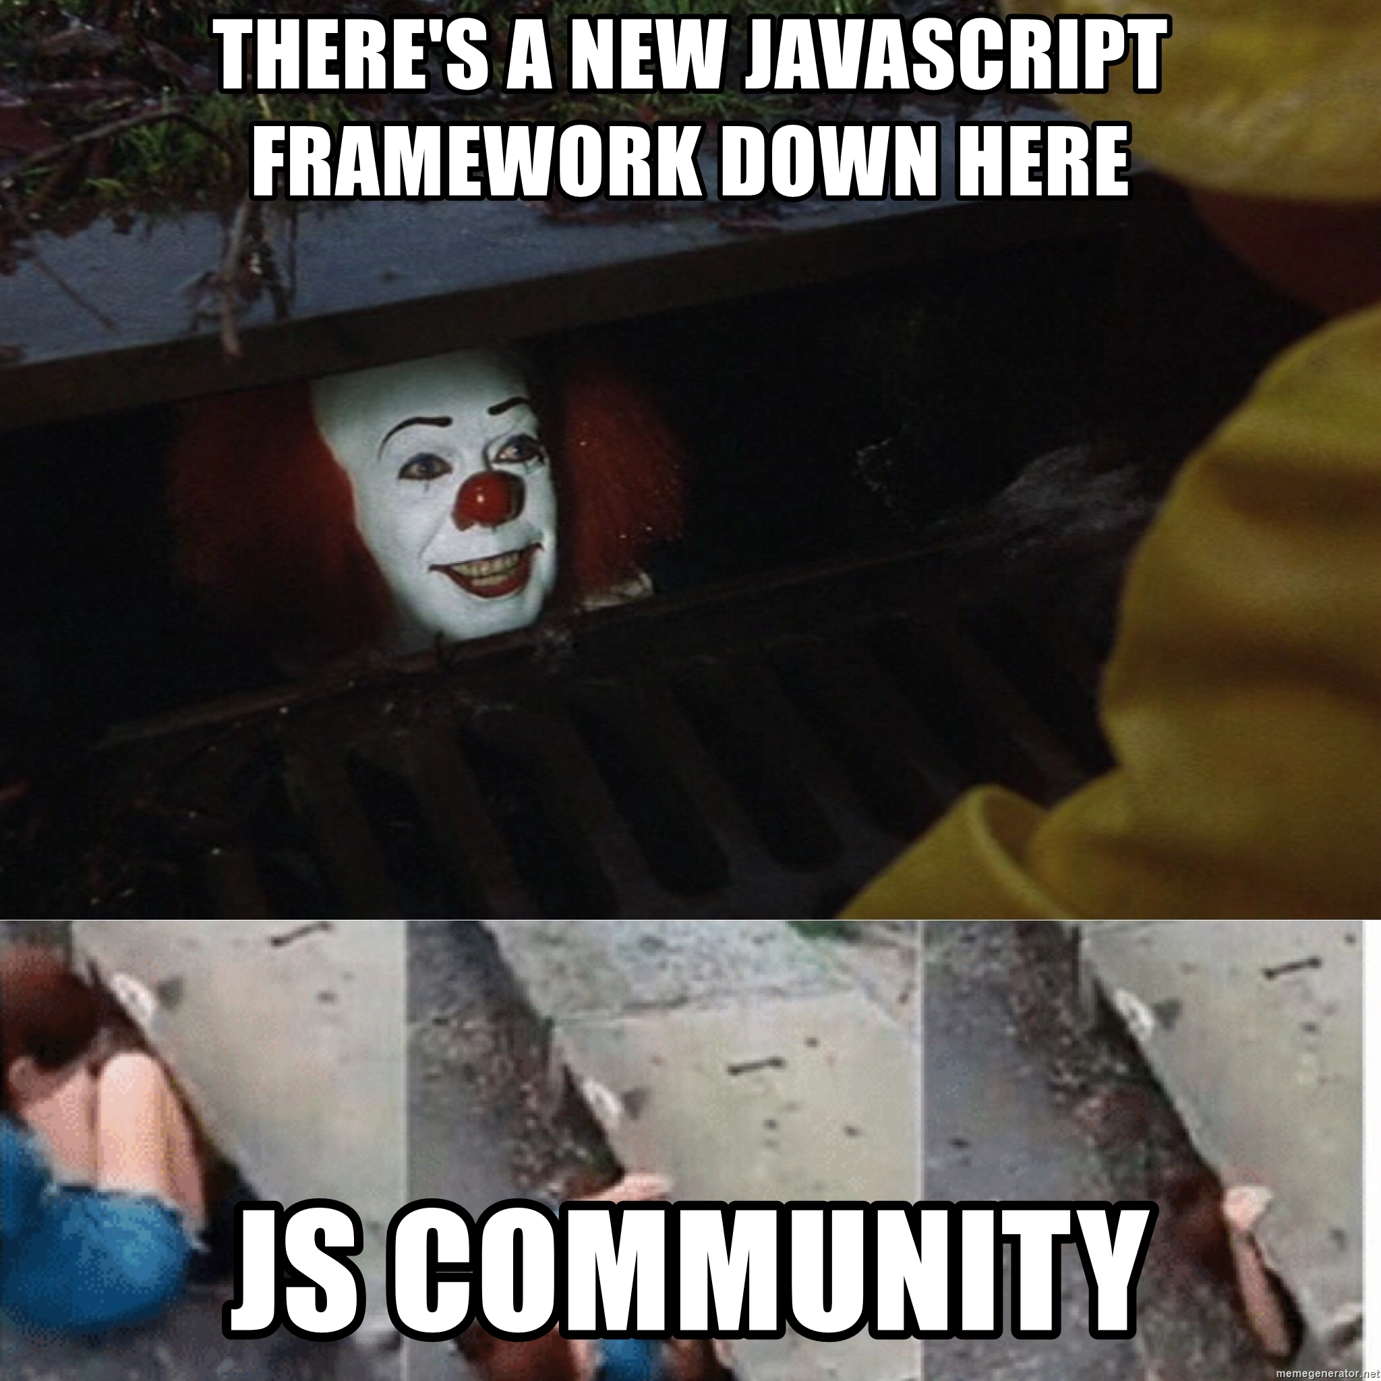
Challenges of a React Developer
The High Pace of Development
Poor Documentation
JSX as a barrier
View Part

Slide 12

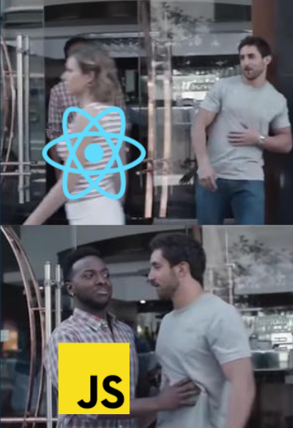
Before getting started with React, you need to have basic knowledge in:
HTML
CSS
JavaScript
Package Manager (NPM/Yarn)

Slide 13
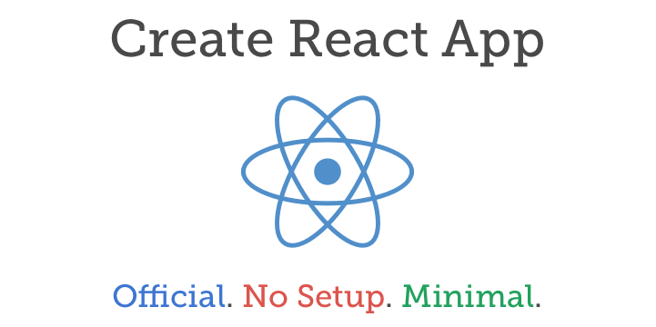
Create Your First React App

Slide 14
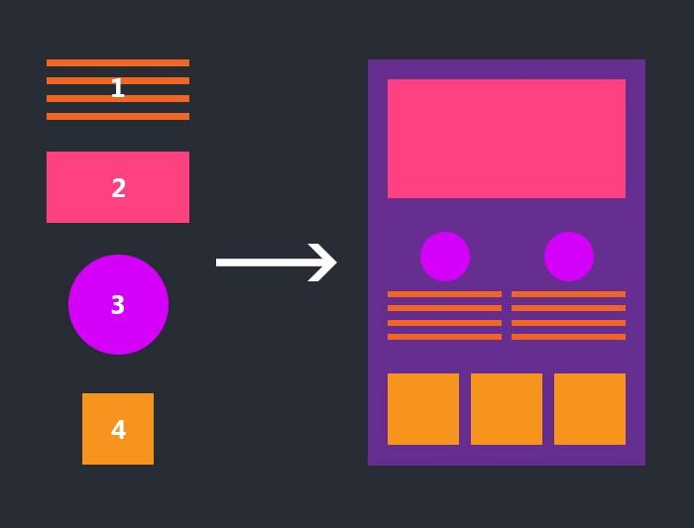
React Components
Components are the building blocks of any React app. Simply put, a component is a JavaScript class or function that optionally accepts inputs and returns a React element that describes how a section of the UI should appear alongside its logic.

Slide 15
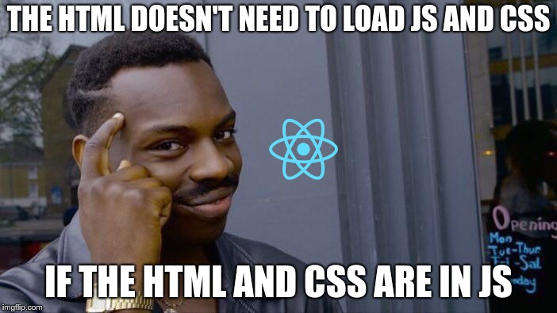
React JSX
JSX is an XML/HTML-like syntax used by React for a cleaner and simpler code. Unlike the past, instead of putting JavaScript into HTML, JSX allows us to put HTML into JavaScript

Slide 16




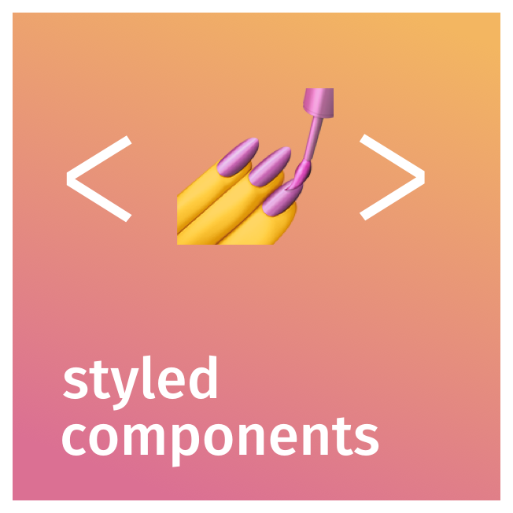

Styling in React

Slide 17
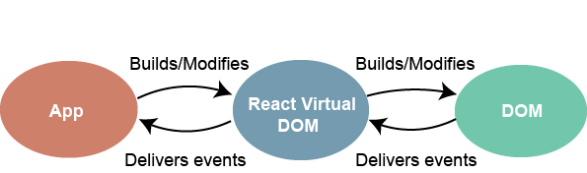
Handling events in React

Slide 18
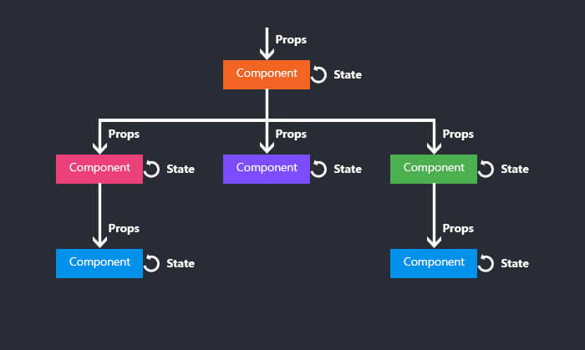
React State
State is a plain JavaScript object used by React to represent an information about the component's current situation. It's managed in the component (just like any variable declared in a function).

Slide 19

React Hooks
Hooks are the new feature introduced in the React 16.8 version which allows you to use state and other React features without writing a class. Hooks are the functions which "hook into" React state and lifecycle features from function components. It does not work inside classes.

Slide 20

React Dev Tools

Slide 21
Lists & Keys in React
Use Array.map method
Not a for loop
Give each item a unique key
Avoid using array index as the key

Slide 22
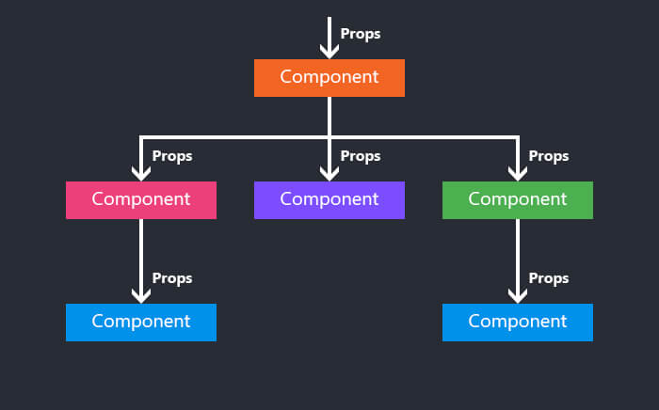
React Props
Props are used to pass data from a parent component to a child component in React and they are the main mechanism for component communication.

Slide 23


That’s all for today

